Slide 1
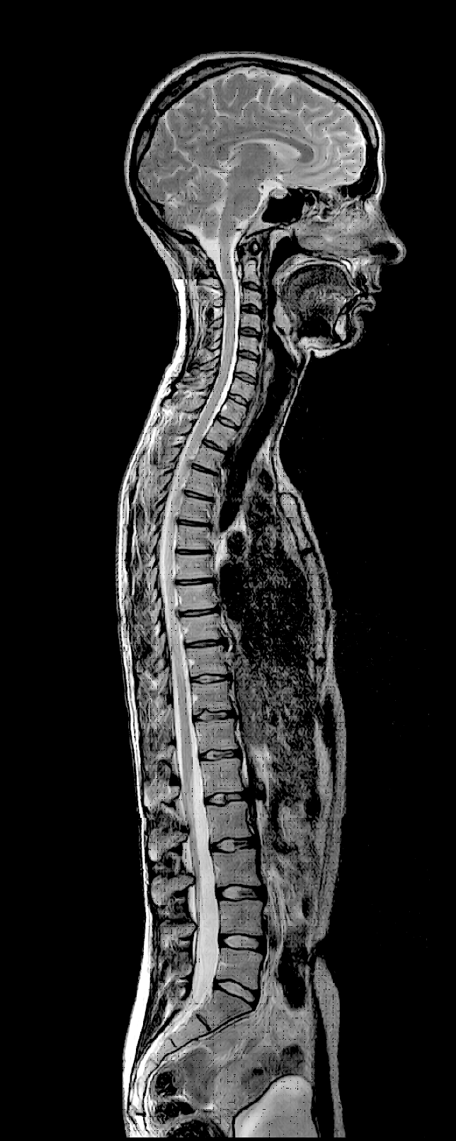
Medical Image
Registration
Notes:
Neuroinformatics
Den Haag, 26 November 2004

Slide 2
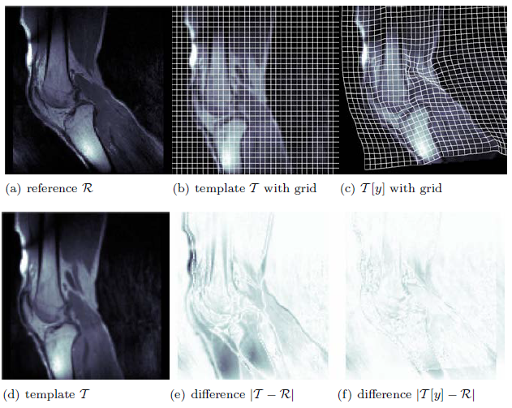
Target

Slide 3
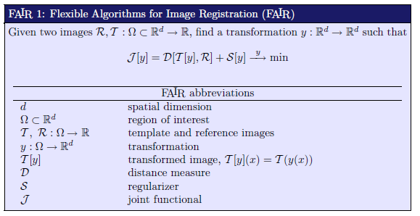
Target

Slide 4
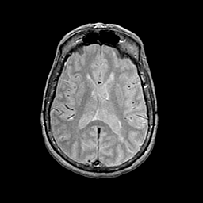
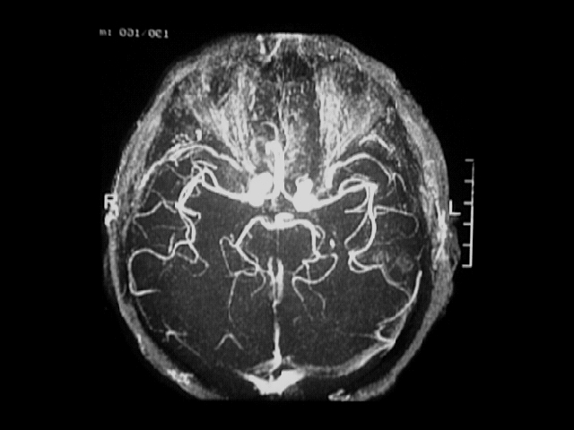
Image registration definition
‘‘ Image registration is about determining a spatial transformation (T) – or mapping – that relates positions in one image, to corresponding positions in one or more other images’’
Template image
Target image
3D - 3D
3D - 2D
3D/2D - patient
Notes:
Neuroinformatics
Den Haag, 26 November 2004

Slide 5
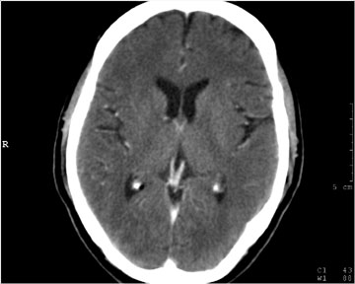
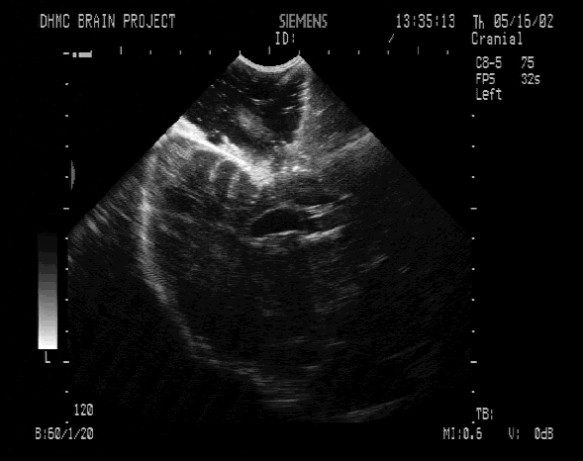
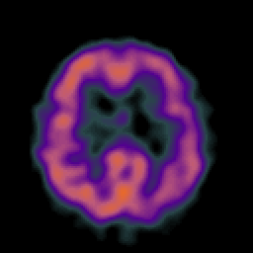
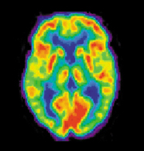
Examples of imaging modalities
MRI
Angiography
X-rays CT
Ultrasound
SPECT
PET
Notes:
Neuroinformatics
Den Haag, 26 November 2004

Slide 6
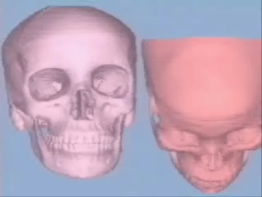
Application of image registration
Same modality, same patient
- monitoring and quantifying disease progression over time,
- evaluation of intra-operative brain deformation, etc…
Different modalities, same patient
- correction for different patient position between scans,
- linking between structural and functional images, etc…
Same modality, different patients
- atlas construction
- studies of variability between subjects, etc…
Notes:
Neuroinformatics
Den Haag, 26 November 2004

Slide 7
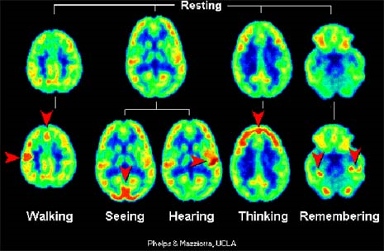
Temporal
registration
PET
Notes:
Neuroinformatics
Den Haag, 26 November 2004

Slide 8
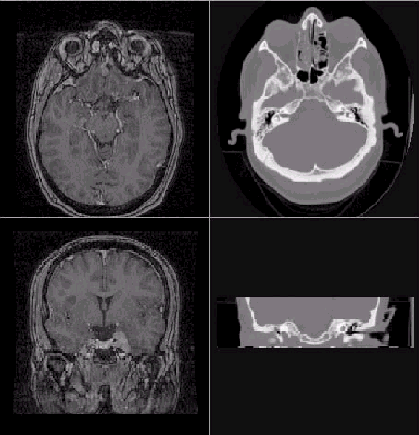
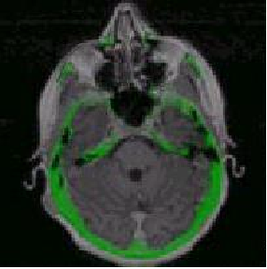
Fusion of images
Colored overlay
MRI
CT
Notes:
Neuroinformatics
Den Haag, 26 November 2004

Slide 9
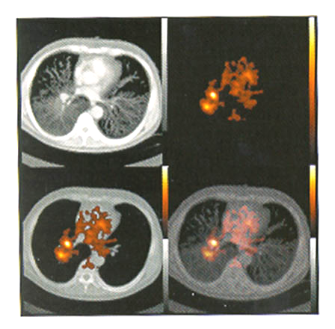
PET - CT
Integration of anatomical
and functional images
Notes:
Neuroinformatics
Den Haag, 26 November 2004

Slide 10
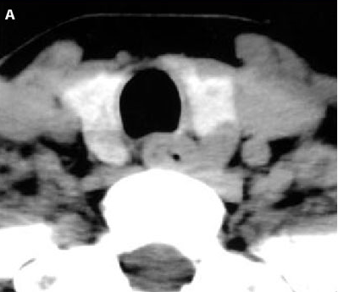
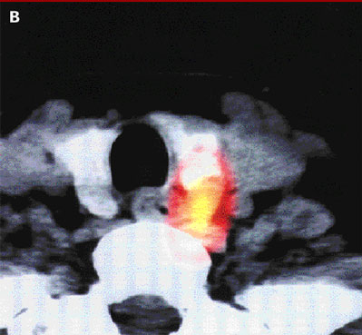
Fusion of images
Region of interest (ROI) selection & color display
CT scan of a thyroid gland
Fusion of SPECT and CT
Notes:
Neuroinformatics
Den Haag, 26 November 2004

Slide 11
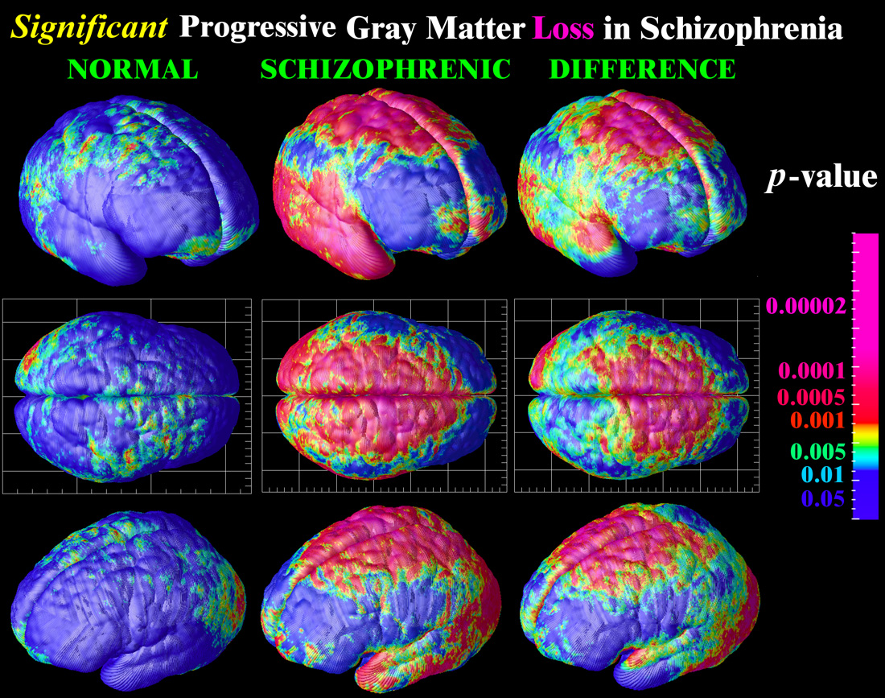
Fusion of images
Mapping of calculated
probability maps
Notes:
Neuroinformatics
Den Haag, 26 November 2004

Slide 12
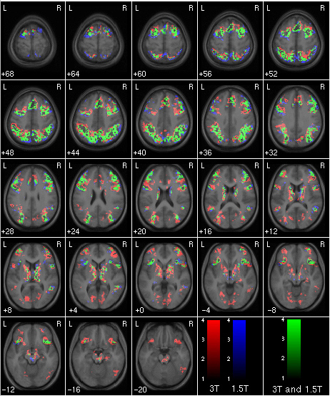
Fusion of images
Functional MRI maps on
Anatomical MRI
fMRI
Notes:
Neuroinformatics
Den Haag, 26 November 2004

Slide 13
Classification of registration algorithms:
Image dimensionality 2D, 3D, time, ...
Registration basis point sets, markers, surfaces, ...
Geometrical transformations affine, perspective, ...
Degree of interaction user initialization, automatic
Optimization procedure max distance, gradient descent
Modalities multi-modal, intra-modal, ...
Subject inter-patient, atlas, ...
Object head, vertebra, liver, ...
Matching with pointbased methods
Matching with surface based methods
Matching with intensity based methods
Notes:
Neuroinformatics
Den Haag, 26 November 2004

Slide 14
Classification of registration algorithms:
Image dimensionality 2D, 3D, time, ...
Registration basis point sets, markers, surfaces, ...
Geometrical transformations affine, perspective, ...
Degree of interaction user initialization, automatic
Optimization procedure max distance, gradient descent
Modalities multi-modal, intra-modal, ...
Subject inter-patient, atlas, ...
Object head, vertebra, liver, ...
Notes:
Neuroinformatics
Den Haag, 26 November 2004

Slide 15
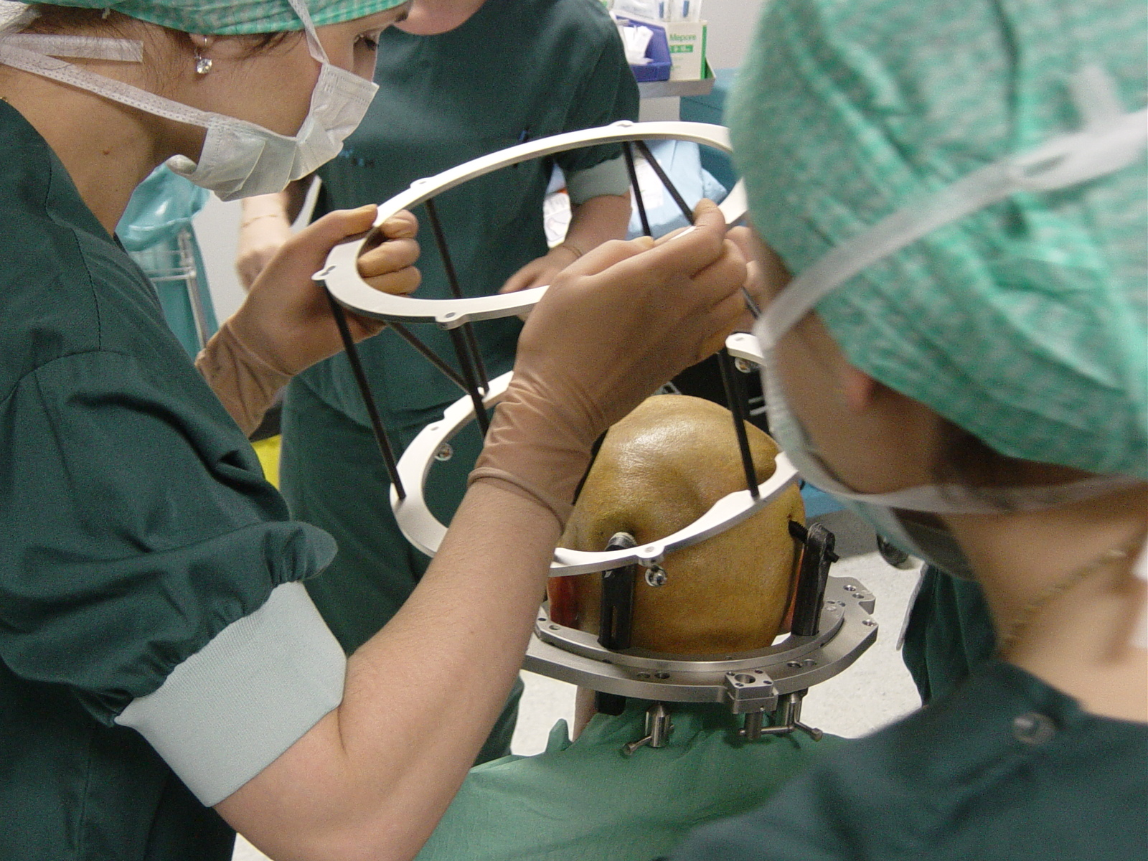
Image markers
Notes:
Neuroinformatics
Den Haag, 26 November 2004

Slide 16
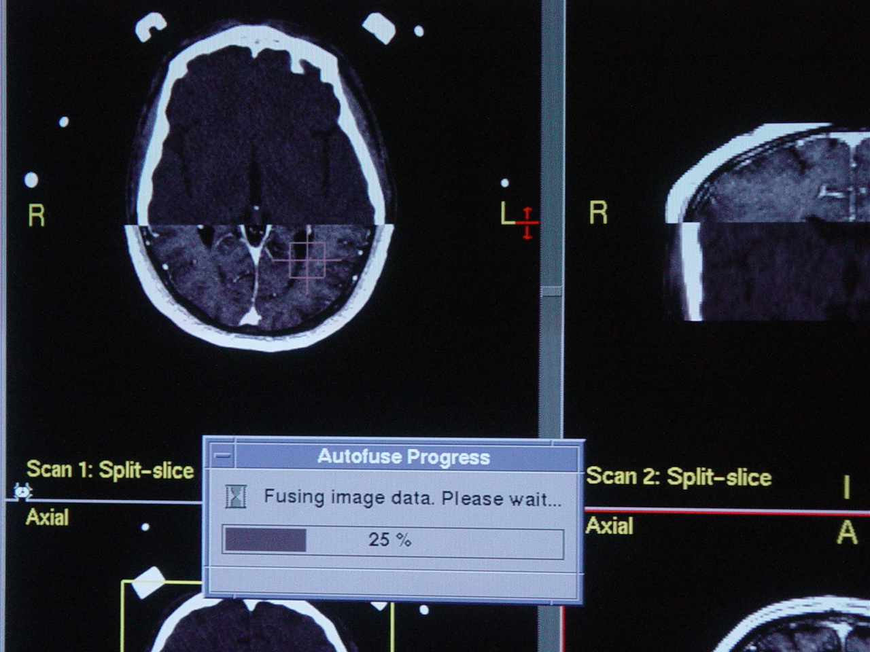
Notes:
Neuroinformatics
Den Haag, 26 November 2004

Slide 17
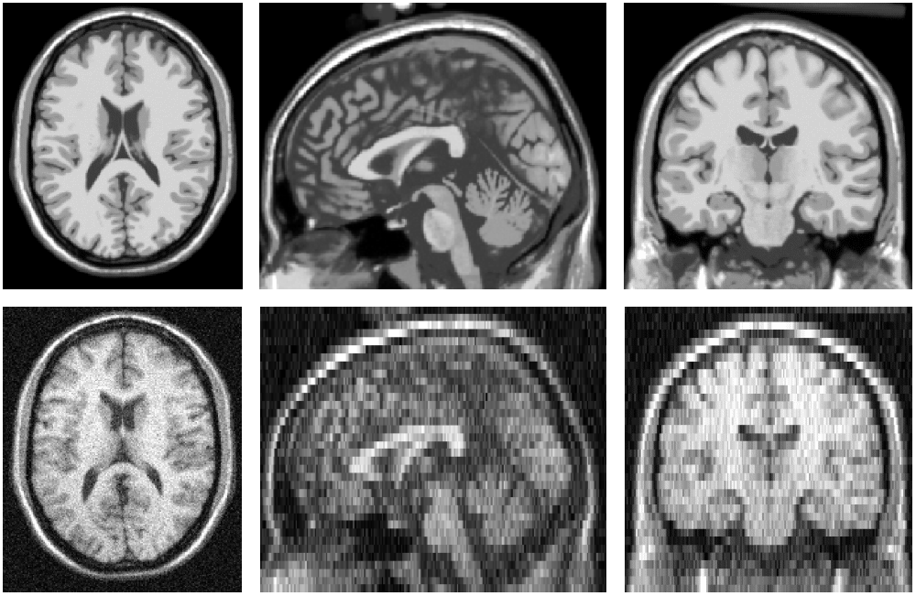
Matching pre-operative MRI (1.5T) onto intra-operative MRI (0.15T)
1.5 Tesla
0.15 Tesla
Notes:
Neuroinformatics
Den Haag, 26 November 2004

Slide 18
Image Registration Framework
Fixed
Image
Metric
Moving
Image
Interpolator
Optimizer
Transform
Parameters
Notes:
Neuroinformatics
Den Haag, 26 November 2004

Slide 19
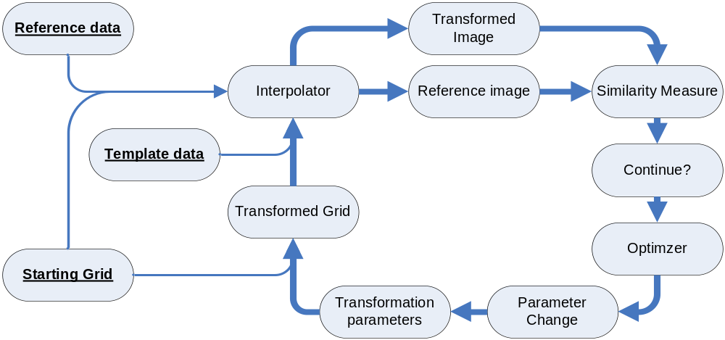
Notes:
Neuroinformatics
Den Haag, 26 November 2004

Slide 20
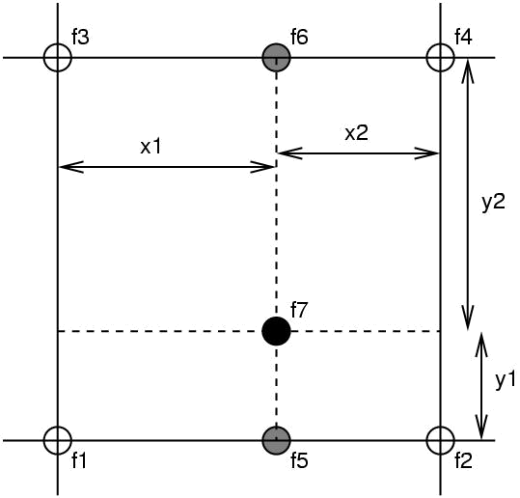
Simple Interpolation
Nearest neighbour
  Take the value of the closest voxel
Tri-linear
  Just a weighted average of the neighbouring voxels
  f₅ = f₁ x₂ + f₂ x₁
  f₆ = f₃ x₂ + f₄ x₁
  f₇ = f₅ y₂ + f₆ y₁

Slide 21
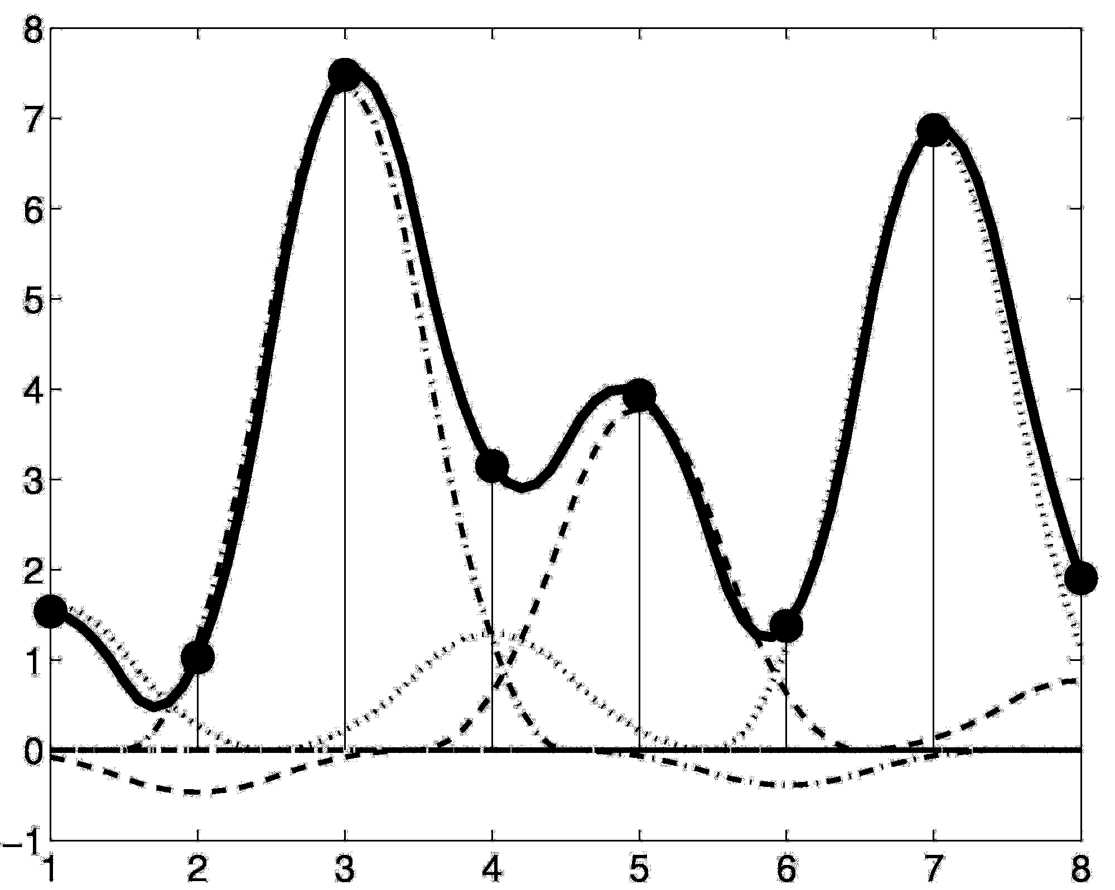
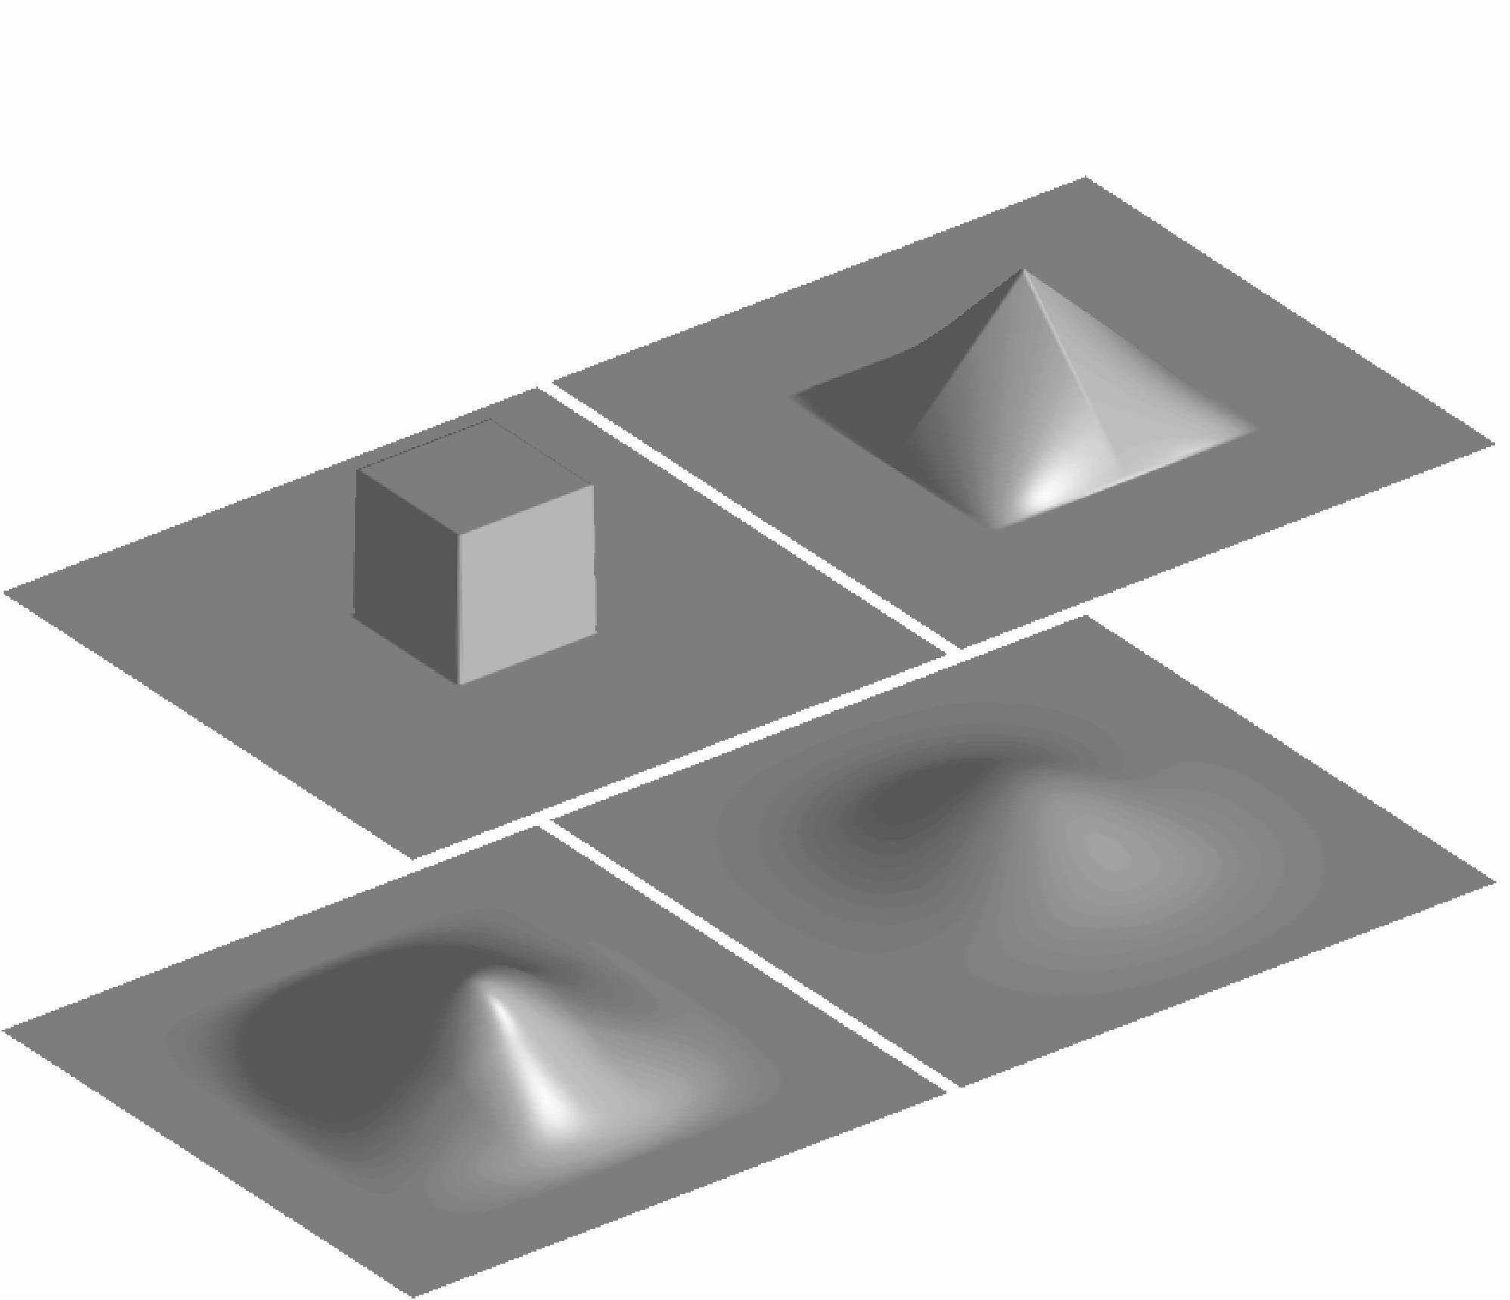
B-spline Interpolation
2D B-spline basis functions of degrees 0, 1, 2 and 3
B-splines are piecewise polynomials

Slide 22
Classification of registration algorithms:
Image dimensionality 2D, 3D, time, ...
Registration basis point sets, markers, surfaces, ...
Geometrical transformations affine, perspective, ...
Degree of interaction user initialization, automatic
Optimization procedure max distance, gradient descent
Modalities multi-modal, intra-modal, ...
Subject inter-patient, atlas, ...
Object head, vertebra, liver, ...
Notes:
Neuroinformatics
Den Haag, 26 November 2004

Slide 23
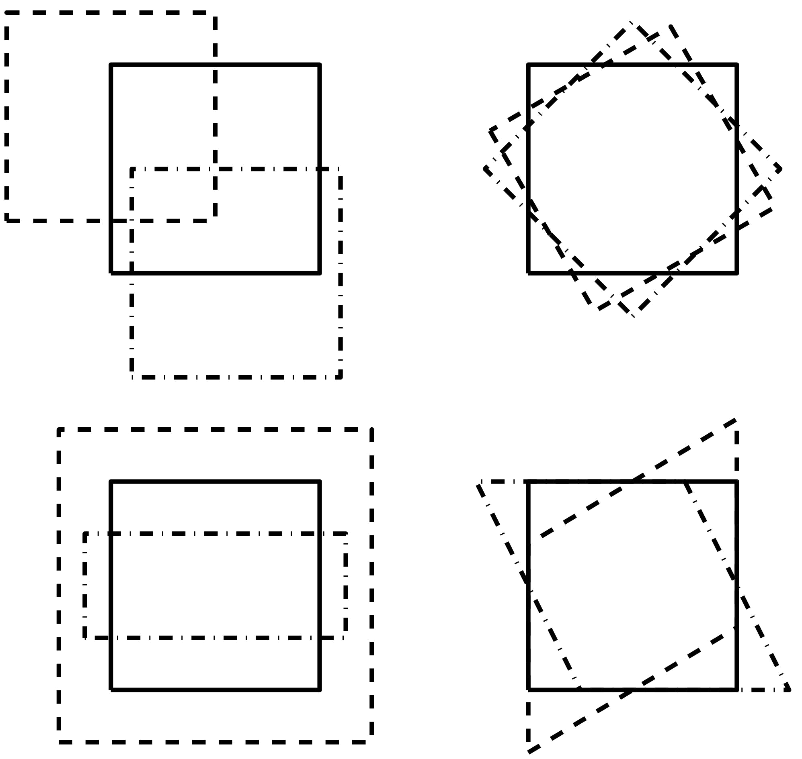
2D Affine Transforms
Translations by t_{x} and t_{y}
  x₁ = a x₀ + b y₀ + t_{x}
  y₁ = c x₀ + d y₀ + t_{y}
Rotation around the origin by Θ radians
  x₁ = cos(Θ) x₀ + sin(Θ) y₀
  y₁ = -sin(Θ) x₀ + cos(Θ) y₀
Zooms by s_{x} and s_{y}
  x₁ = s_{x} x₀
  y₁ = s_{y} y₀
Shear
  x₁ = x₀ + h y₀
  y₁ = y₀
Notes:
Neuroinformatics
Den Haag, 26 November 2004

Slide 24
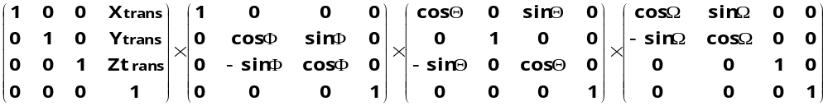
3D Rigid-body Transformations
A 3D rigid body transform is defined by:
  3 translations - in X, Y & Z directions
  3 rotations - about X, Y & Z axes
The order of the operations matters
Translations
Pitch
about x axis
Roll
about y axis
Yaw
about z axis
Notes:
Neuroinformatics
Den Haag, 26 November 2004

Slide 25
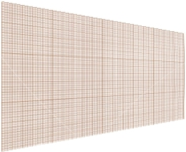
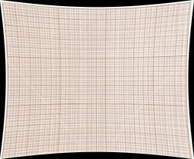
Geometrical transformations
Rigid
  preserves straightness of lines
  intra-patient, rigid anatomy
  rotation, translation, zoom, skew
Curved
  inter-patient
  atlas
  tissue deformation
Notes:
Neuroinformatics
Den Haag, 26 November 2004

Slide 26
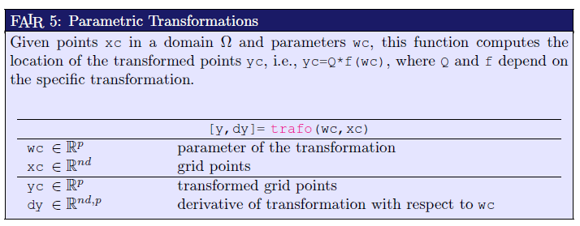

Slide 27
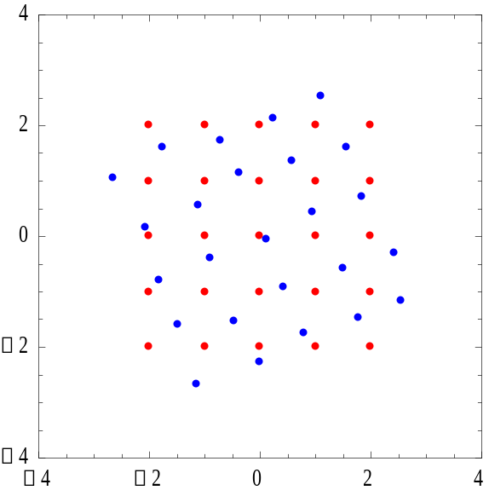
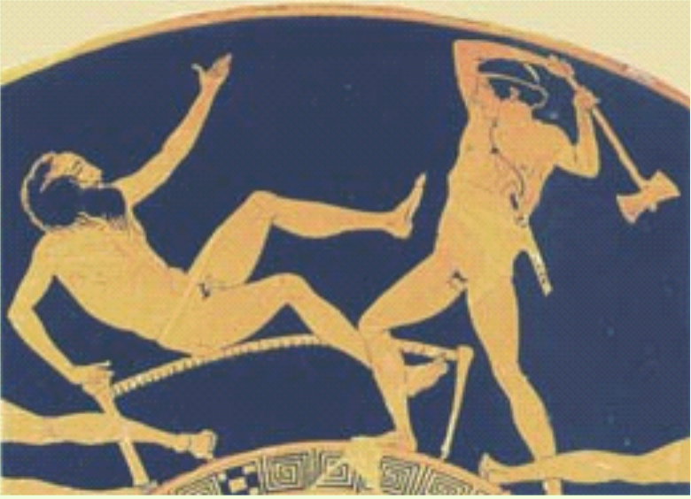
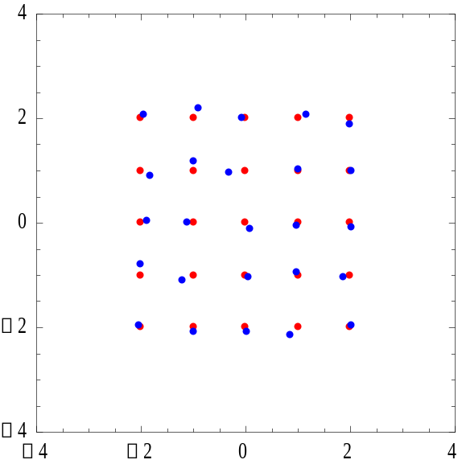
Point set matching: the Procrustes Algorithm
Notes:
Neuroinformatics
Den Haag, 26 November 2004

Slide 28
Intensity-Based Registration
Some measure of similarity is computed between two images, using only images intensities (gray levels/colors).
The similarity measure between the images must be maximized (optimized).
Notes:
Neuroinformatics
Den Haag, 26 November 2004

Slide 29
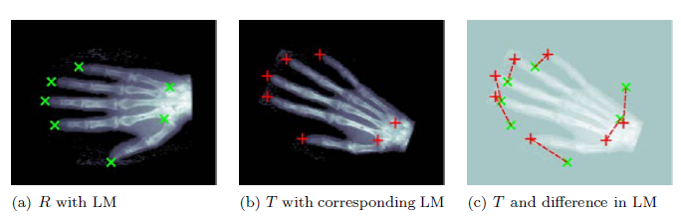
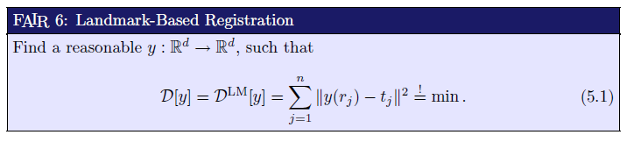

Slide 30
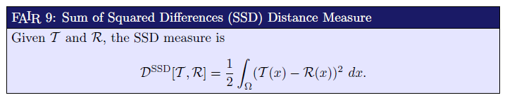
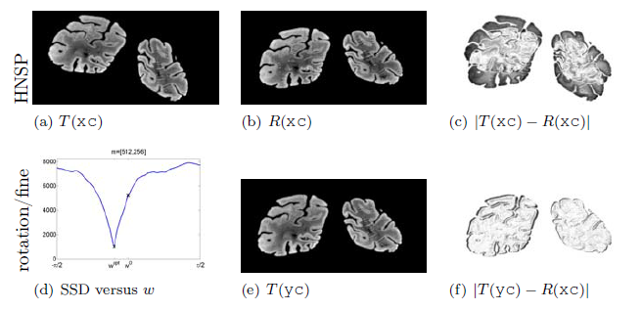
Image Metrics – similarity measures
Notes:
Neuroinformatics
Den Haag, 26 November 2004

Slide 31
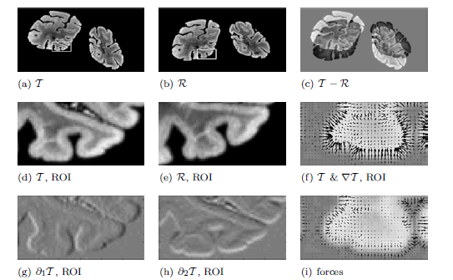

Slide 32
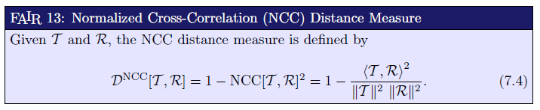
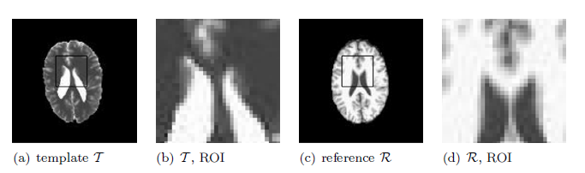
Image Metrics – similarity measures
Notes:
Neuroinformatics
Den Haag, 26 November 2004

Slide 33
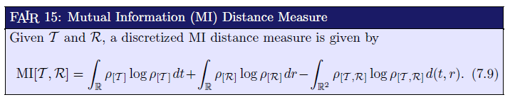
Image Metrics – similarity measures
Notes:
Neuroinformatics
Den Haag, 26 November 2004

Slide 34
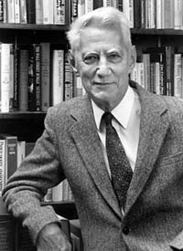
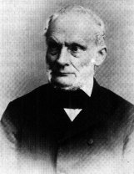
Similarity Based on Information Theory
Entropy
  A measure of dispersion or disorder.
  High entropy ⇒ high disorder.
Rudolf Clausius (1862)
Claude Shannon (1948)
Notes:
Neuroinformatics
Den Haag, 26 November 2004

Slide 35
Similarity Based on Information Theory
Entropy
  A measure of dispersion or disorder.
  High entropy ⇒ high disorder.
Mutual information
  A measure of how well one random variable (image intensities) “explains” another.
  High mutual information ⇒ high similarity
Notes:
Neuroinformatics
Den Haag, 26 November 2004

Slide 36
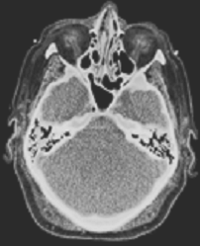
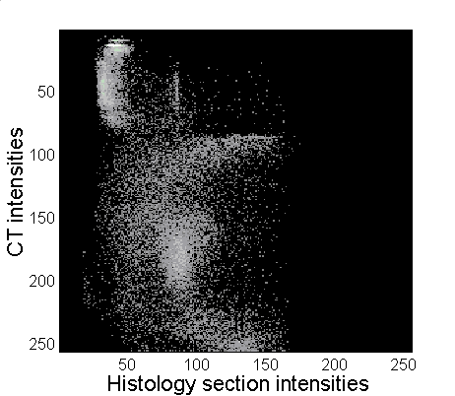
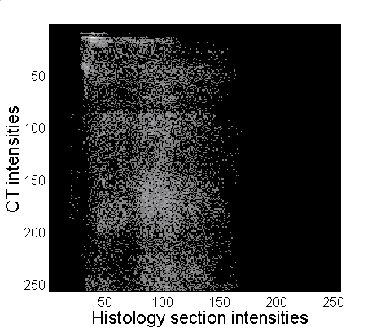
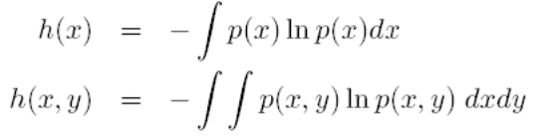
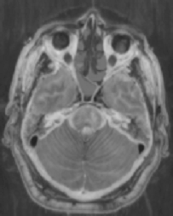

Mutual Information
Correct registration
Large mis-registration
Entropy
Mutual information
Normalized mutual information
Wachowiak et al.,
Proc. SPIE Medical Imaging, 2003
Notes:
Neuroinformatics
Den Haag, 26 November 2004

Slide 37
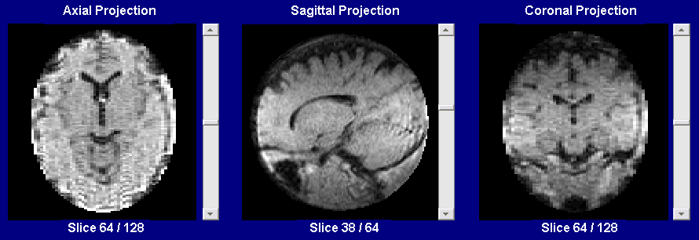
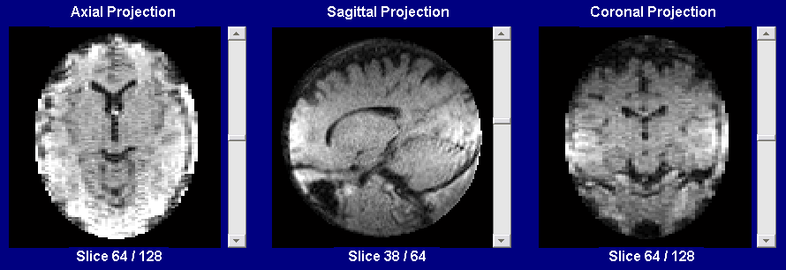
Pre-processing: Slow gradient Removal
  substract peaks of strongly Gaussian blurred image
Notes:
Neuroinformatics
Den Haag, 26 November 2004

Slide 38
Pre-processing: Slow gradient Removal
  substract peaks of strongly Gaussian blurred image
Notes:
Neuroinformatics
Den Haag, 26 November 2004

Slide 39


Edge Removal
Shrink binary mask
Notes:
Neuroinformatics
Den Haag, 26 November 2004

Slide 40
Edge Removal
Shrink binary mask
Notes:
Neuroinformatics
Den Haag, 26 November 2004

Slide 41
Image Metrics
Fixed
Image
Metric
Value
Moving
Image
Interpolator
Transform
Parameters
Notes:
Neuroinformatics
Den Haag, 26 November 2004

Slide 42

Evaluating many matches
y
y
Transform
x
x
Fixed Image
Moving Image
Notes:
Neuroinformatics
Den Haag, 26 November 2004

Slide 43


Slide 44
Classification of registration algorithms:
Image dimensionality 2D, 3D, time, ...
Registration basis point sets, markers, surfaces, ...
Geometrical transformations affine, perspective, ...
Degree of interaction user initialization, automatic
Optimization procedure max distance, gradient descent
Modalities multi-modal, intra-modal, ...
Subject inter-patient, atlas, ...
Object head, vertebra, liver, ...
Notes:
Neuroinformatics
Den Haag, 26 November 2004

Slide 45

Plotting the Metric
Sensitivity analysis
Mean Squared Differences
Transform Parametric Space
Notes:
Neuroinformatics
Den Haag, 26 November 2004

Slide 46
The Best Transform Parameters
Evaluation of the
full parameter space
is equivalent to performing
optimization by exhaustive search
Very Safe
but
Very Slow
Better Optimization Methods:
for example: Gradient Descent
Notes:
Neuroinformatics
Den Haag, 26 November 2004

Slide 47
Optimization in Image Registration
Main goal: To determine the transformation parameters that result in the minimum value of a ‘distance measure’.
Transformation parameters:
  Translations
  Rotations
  Scaling
Find the “best”, or optimum value of an objective (cost) function.
Very large research area.
Multitude of applications.
Notes:
Neuroinformatics
Den Haag, 26 November 2004

Slide 48
Applications of Optimization
Engineering design
Business and
industry
Biology and
medicine
Design of
materials
Economics
Radiotherapy
planning
Manufacturing
design
Finance
Bioinformatics
Proteomics
Simulation and
modeling
Management
Systems biology
Image registration
Notes:
Neuroinformatics
Den Haag, 26 November 2004

Slide 49


Global and local optimization
Notes:
Neuroinformatics
Den Haag, 26 November 2004

Slide 50
Local Optimization
Start
Notes:
Neuroinformatics
Den Haag, 26 November 2004

Slide 51
Local Optimization
End
Notes:
Neuroinformatics
Den Haag, 26 November 2004

Slide 52
Global Optimization
Start
Notes:
Neuroinformatics
Den Haag, 26 November 2004

Slide 53
Global Optimization
End
Notes:
Neuroinformatics
Den Haag, 26 November 2004

Slide 54
Image Registration Framework
Fixed
Image
Metric
Moving
Image
Interpolator
Optimizer
Transform
Parameters
Notes:
Neuroinformatics
Den Haag, 26 November 2004

Slide 55
Gradient Descent Optimizer
f( x , y )
S = Step
L = Learning
Rate
G( x , y ) =
∆
f( x , y )
S = L ∙ G( x , y )
Notes:
Neuroinformatics
Den Haag, 26 November 2004

Slide 56
Gradient Descent Optimizer
f( x , y )
G( x , y ) =
∆
f( x , y )
S = L ∙ G( x , y )
Notes:
Neuroinformatics
Den Haag, 26 November 2004

Slide 58



Slide 59


Slide 60


Slide 61


Slide 62
Multi-Resolution Registration Framework
Registration
Registration
Registration
Fixed Image
Moving Image
Notes:
Neuroinformatics
Den Haag, 26 November 2004

Slide 63
Classification of registration algorithms:
Image dimensionality 2D, 3D, time, ...
Registration basis point sets, markers, surfaces, ...
Geometrical transformations affine, perspective, ...
Degree of interaction user initialization, automatic
Optimization procedure max distance, gradient descent
Modalities multi-modal, intra-modal, ...
Subject inter-patient, atlas, ...
Object head, vertebra, liver, ...
Notes:
Neuroinformatics
Den Haag, 26 November 2004

Slide 64



Multi-Modality Registration
Moving Image
Registered Moving Image
Fixed Image
Notes:
Neuroinformatics
Den Haag, 26 November 2004

Slide 65
Classification of registration algorithms:
Image dimensionality 2D, 3D, time, ...
Registration basis point sets, markers, surfaces, ...
Geometrical transformations affine, perspective, ...
Degree of interaction user initialization, automatic
Optimization procedure max distance, gradient descent
Modalities multi-modal, intra-modal, ...
Subject inter-patient, atlas, ...
Object head, vertebra, liver, ...
Notes:
Neuroinformatics
Den Haag, 26 November 2004

